Slide 1
BANK ANALYTICS PROJECT
Project ID: P1343
TEAM MEMBERS : SANJIVANI MESHRAM
SHABANAM KHAN
SUMIT MITTAL
MAYUR VARKAL
AKSHAYA ESHWAR L
PARTH DESHMUKH
KANAKABOINA RAJASEKHAR

Slide 2
TABLE OF CONTENT
1. PROJECT INTRODUCTION
2. PROJECT OBJECTIVES
3. WHAT WE LEARNED
4. BANK ANALYTICS KPIs
5. BANK CREDIT & DEBIT KPIs
6. EXCEL DASHBOARDS
7. POWER BI DASHBOARDS
8. TABLEAU DASHBOARDS
9. SQL KPI QUERIES
10. KEY INSIGHTS
11. CONCLUSION

Slide 3
PROJECT INTRODUCTION
Bank Analytics is a data analysis and visualization project focused on analyzing banking data and transforming it into meaningful insights. The project covers two major areas: loan analytics and credit & debit transaction analytics. Interactive dashboards were created using Excel, Power BI, and Tableau to analyze key banking KPIs, trends, and performance.

Slide 4
PROJECT OBJECTIVES
To analyze banking transaction data.
To analyze loan performance, collections, interest, and delinquency.
To compare credit and debit transactions.
To identify transaction trends over time.
To analyze different transaction methods.
To create interactive dashboards for better data analysis and decision-making.

Slide 5
WHAT WE LEARNED
Learned how to clean, organize, and prepare data for analysis.
Learned how Excel uses formulas, Pivot Tables, Pivot Charts, and slicers for quick and flexible data analysis.
Explored Power BI features such as DAX measures, data modeling, interactive visuals, and cross-filtering for dynamic reporting.
Learned how Tableau uses worksheets, calculated fields, the Marks card, and drag-and-drop features for interactive visual analysis.
Used SQL to calculate and validate KPIs accurately.
Understood how Excel, Power BI, and Tableau provide different approaches to analyzing and presenting the same data.
Learned how interactive dashboards help identify trends, compare performance, and convert raw data into useful business insights.

Slide 6
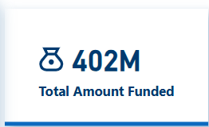
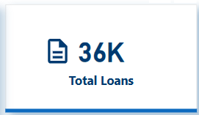
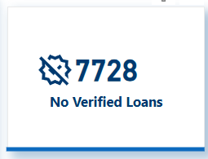
BANK ANALYTICS KPIs
Represents the total amount funded across all loans. It helps measure the bank’s overall lending volume and financial activity.
Represents the total number of loans recorded in the dataset. It provides an overview of the bank’s overall loan portfolio and lending activity.
Represents the total number of loans that have not been verified. It helps identify pending or unverified loan records that may require further review or validation.

Slide 7
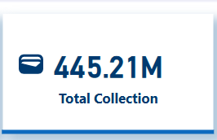
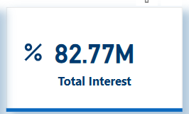
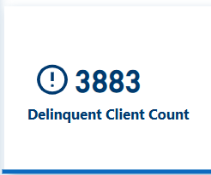
Represents the total amount collected from borrowers. It helps measure overall loan repayments and the bank’s collection performance.
Represents the total interest earned from all loans. It helps measure the income generated through the bank’s lending activities.
Represents the total number of clients with overdue or delayed loan payments. It helps identify clients with repayment issues and assess potential credit risk.

Slide 8
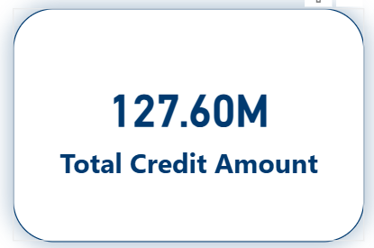
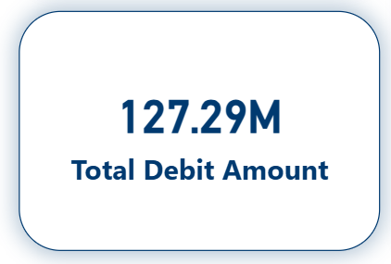
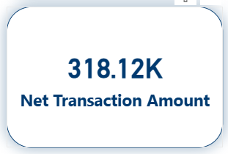
BANK CREDIT & DEBIT KPIs
Represents the total value of all credit transactions. It shows the overall amount of money credited or received.
Represents the total value of all debit transactions. It shows the overall amount of money debited or spent.
Represents the difference between total credit and total debit amounts. It helps determine the overall net flow of money.

Slide 9
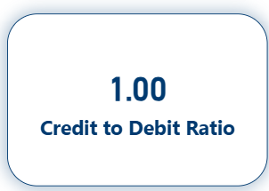
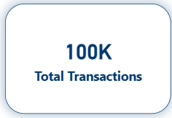
Represents the relationship between total credit and debit transactions. It helps evaluate the balance between money received and money spent.
Represents the total number of transactions recorded in the dataset. It helps measure the overall transaction volume and understand the level of banking activity.

Slide 10
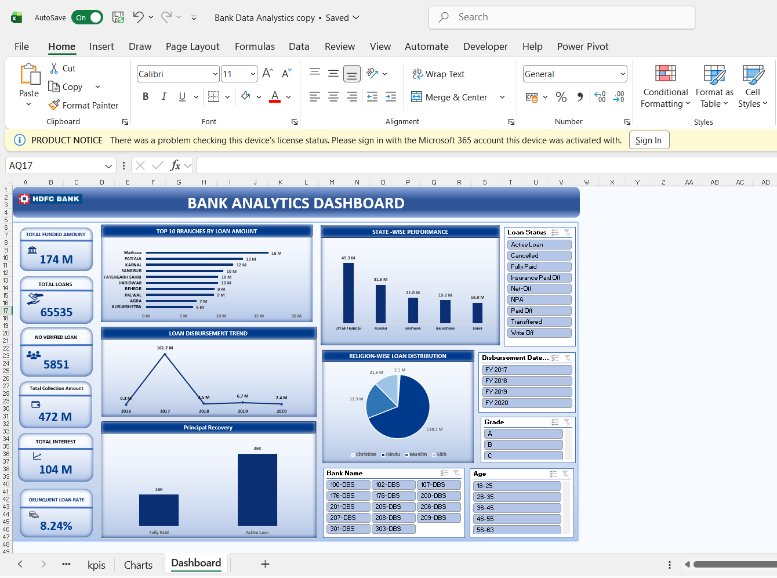
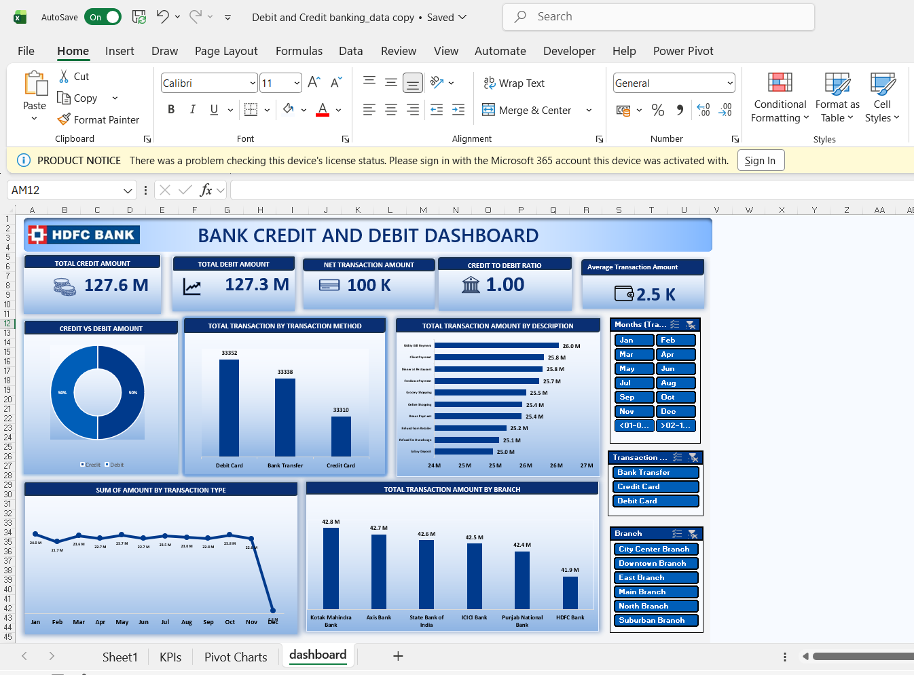
EXCEL DASHBOARDS
Both dashboards were created in Microsoft Excel using Pivot Tables, Pivot Charts, formulas, and slicers. Excel was useful for cleaning, organizing, and summarizing raw banking data. Its spreadsheet-based structure, formulas, Pivot Tables, and easy data manipulation made it useful for quick analysis and dashboard creation.

Slide 11
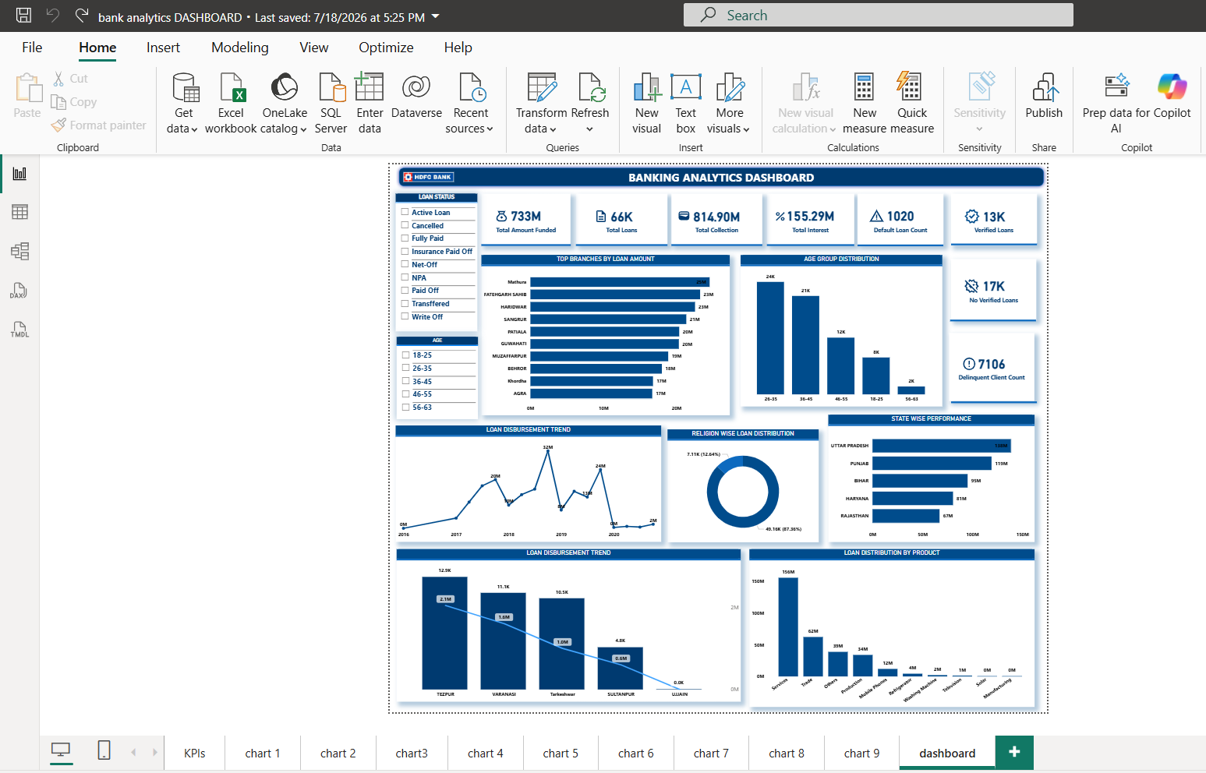
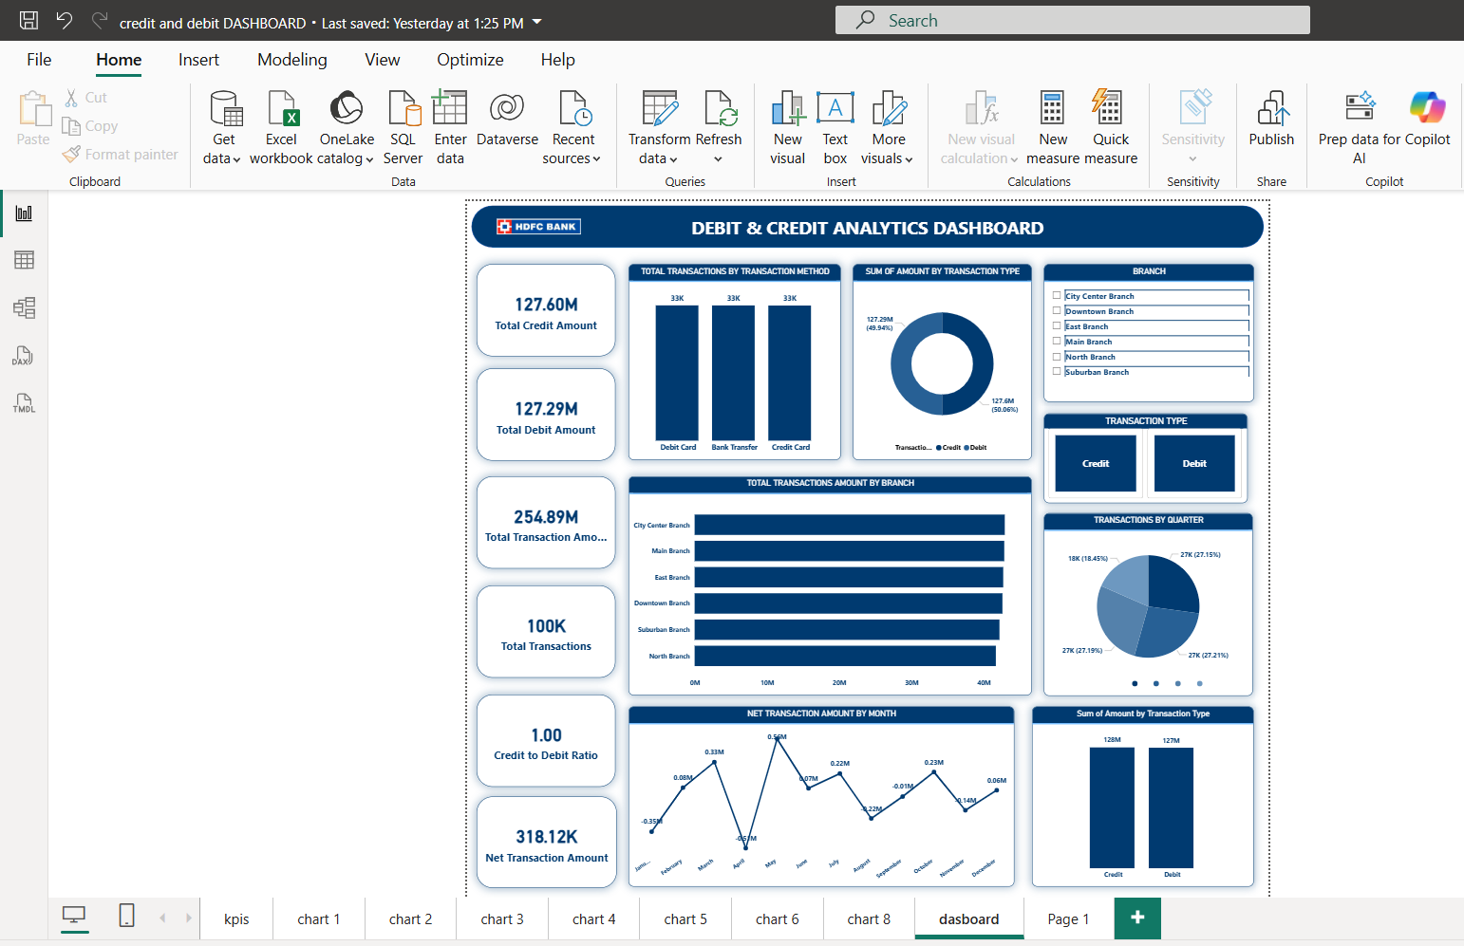
POWER BI DASHBOARDS
Both dashboards were developed in Power BI using DAX measures, KPI cards, interactive visuals, and filters. Its data modeling, DAX calculations, cross-filtering, and interactive visuals make the dashboard dynamic, allowing multiple visuals to respond automatically to user selections.

Slide 12
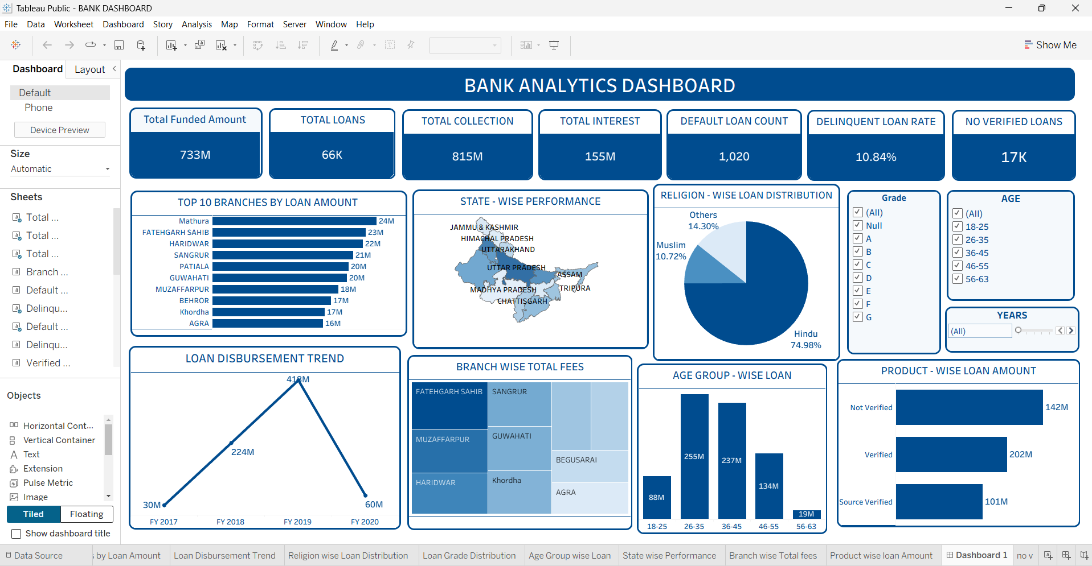
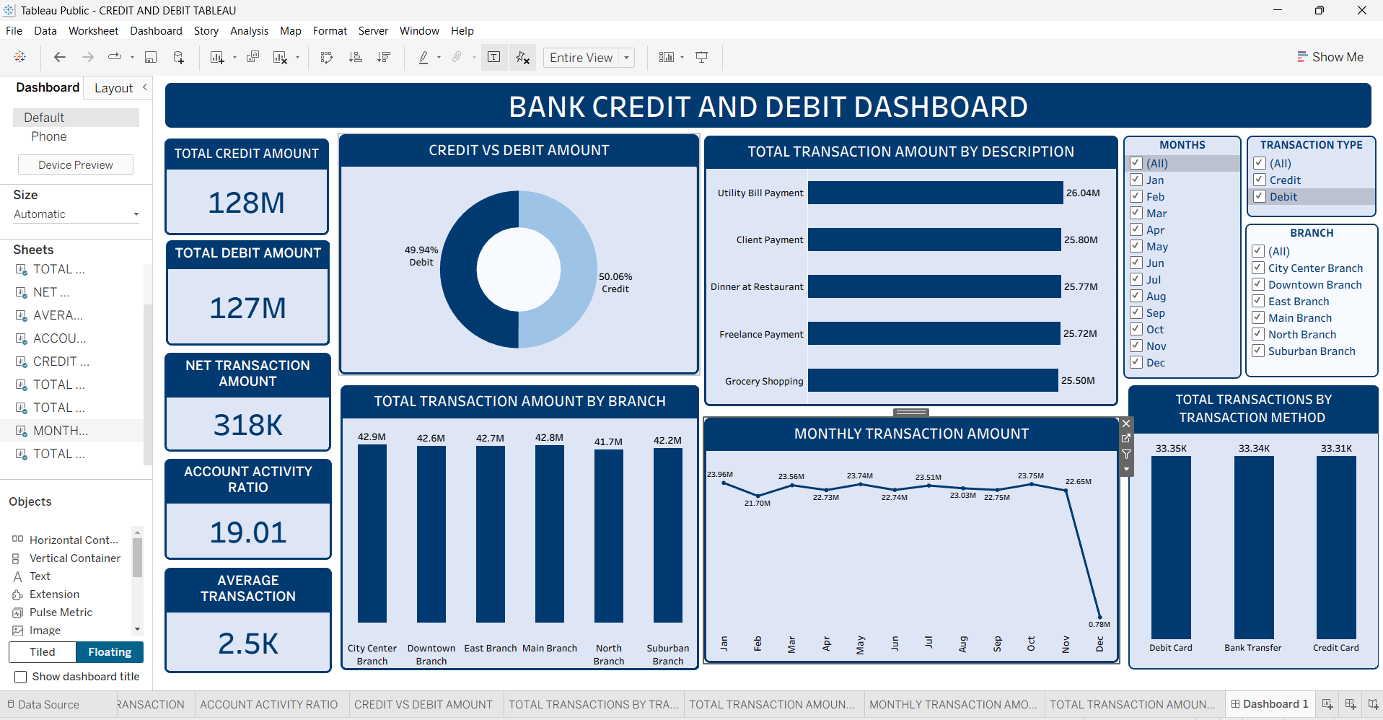
TABLEAU DASHBOARDS
Both dashboards were created in Tableau using calculated fields, worksheets, filters, and interactive visualizations. Its drag-and-drop visual analysis, individual worksheets, Marks card, calculated fields, and dashboard interactions make it useful for exploring patterns and presenting data clearly.

Slide 13
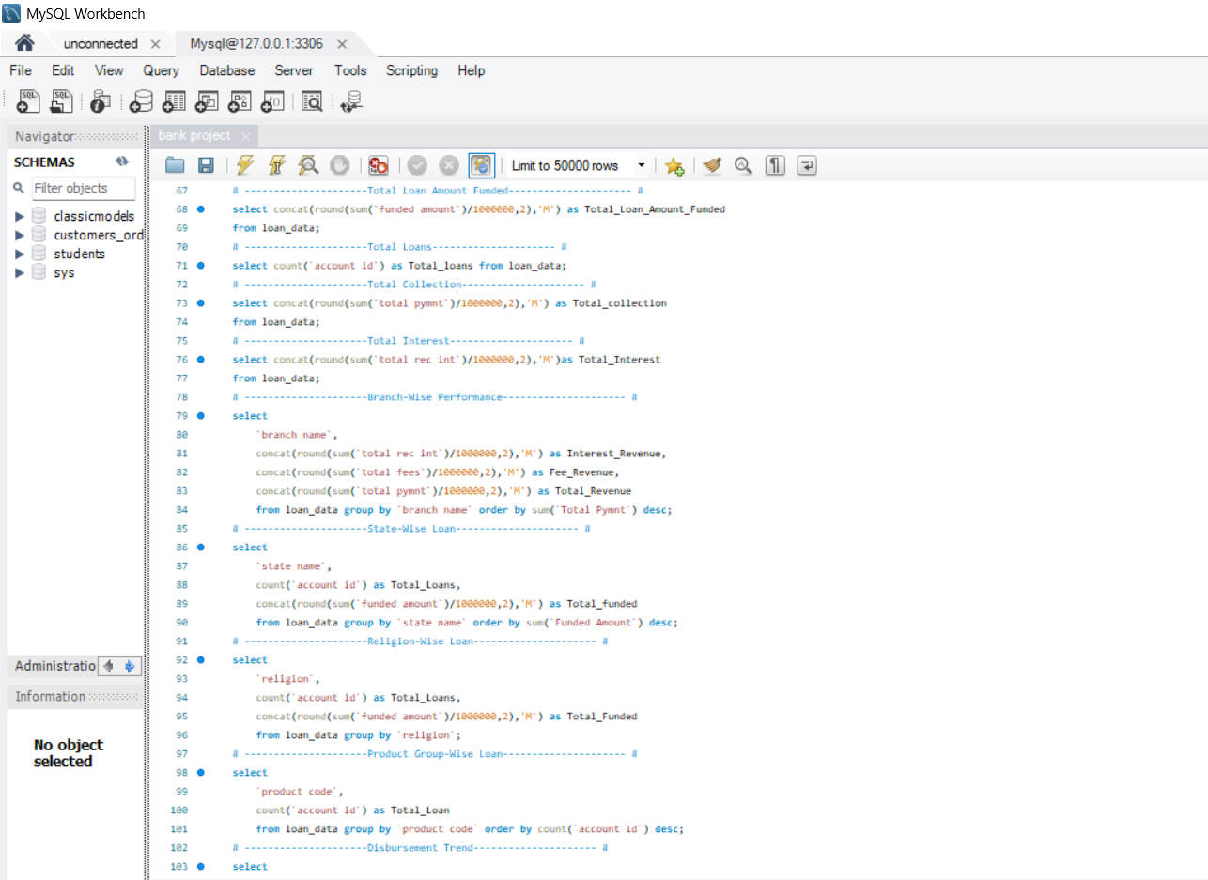
SQL KPI QUERIES
MySQL was used to calculate and validate the key performance indicators (KPIs) required for the project. SQL queries were written to calculate metrics such as Total Funded Amount, Total Loans, Total Collection, Total Interest, and other important banking KPIs. This helped ensure accurate KPI values before presenting them in the dashboards.

Slide 14
KEY INSIGHTS
Loan Analytics
Loan performance varies across branches and states.
Collection and interest KPIs help evaluate overall lending performance.
Delinquency analysis helps identify potential repayment risk.
Credit & Debit Analytics
Credit and debit amounts are nearly balanced.
Transaction activity can be compared across methods, months and branches.
Interactive filters allow more detailed transaction analysis.

Slide 15
CONCLUSION
The Bank Analytics project helped us understand how raw banking data can be transformed into meaningful insights using data analysis and visualization tools.
Through this project, we gained practical experience in data cleaning, SQL-based KPI calculations,, KPI creation, Excel, Power BI, Tableau, dashboard development, and data visualization.
The dashboards make it easier to understand transaction patterns, monitor important KPIs, and compare banking performance.

Slide 16
THANK YOU!

